Slide 1
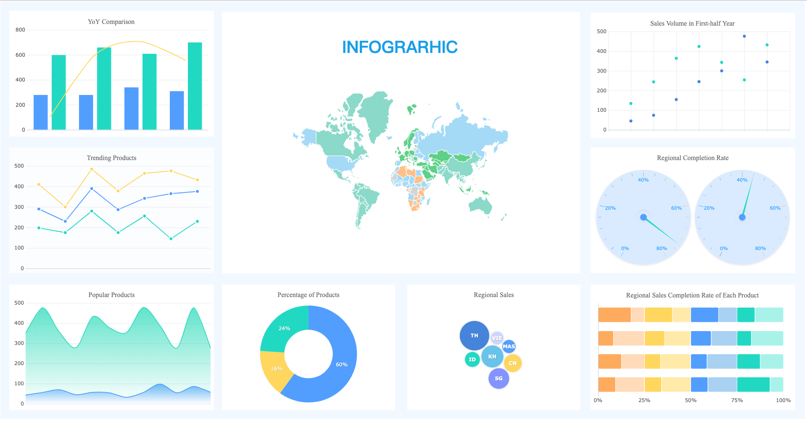
Module 2: Data Visualization and Communication Quiz, Visualization and Tableau
Siddharth Sundar
MyAnatomy Integration
NCET Core Team

Slide 2



Please download and install the Slido app on all computers you use
What is the correct way to write a function, from the below options?
ⓘ Start presenting to display the poll results on this slide.

Slide 3
Please download and install the Slido app on all computers you use
What is they keyboard shortcut to lock references in a cell?
ⓘ Start presenting to display the poll results on this slide.

Slide 4
Please download and install the Slido app on all computers you use
What is the correct shortcut for AutoSum?
ⓘ Start presenting to display the poll results on this slide.

Slide 5
Please download and install the Slido app on all computers you use
Maths - 100, Science - 94, Social Studies - 99, English - 72, Hindi - 75. Row A2-A6. Assuming that each of these subjects are scored out of 100, how would you write a formula on excel to calculate the PERCENTAGE of the candidate?
ⓘ Start presenting to display the poll results on this slide.

Slide 6
Please download and install the Slido app on all computers you use
What is the value of the parameter "Exact Match", in MATCH Function parameter [Match_Type]?
ⓘ Start presenting to display the poll results on this slide.

Slide 7
Please download and install the Slido app on all computers you use
What is the order of the mandatory parameters in the XLOOKUP Function?
ⓘ Start presenting to display the poll results on this slide.

Slide 8
Please download and install the Slido app on all computers you use
Unit Price = 50₹, Cost per Unit = 30₹, Fixed Costs = ₹50000, Variable Costs = ₹30000, UNITS SOLD = 10000 units, REVENUE = ₹50000. What should my Unit Price change to, to break-even?
ⓘ Start presenting to display the poll results on this slide.

Slide 9
Please download and install the Slido app on all computers you use
What is the right order to get the correct answer in Goal Seek?
ⓘ Start presenting to display the poll results on this slide.

Slide 10
Please download and install the Slido app on all computers you use
Which of these is not a lookup function?
ⓘ Start presenting to display the poll results on this slide.

Slide 11
Please download and install the Slido app on all computers you use
How do you refer to a range, if it belongs to a table named "Data"
ⓘ Start presenting to display the poll results on this slide.

Slide 12
Please download and install the Slido app on all computers you use
Which Visualization Tool is the best to represent the percentage of customers preference for a particular product?
ⓘ Start presenting to display the poll results on this slide.

Slide 13
Please download and install the Slido app on all computers you use
Which Visualization Tool is the best to represent the percentile of students taking the NCET exam?
ⓘ Start presenting to display the poll results on this slide.

Slide 14
Please download and install the Slido app on all computers you use
Apple - 35, Banana - 35, Mango - 30. Assume that these are the counts of preferences of my customers. What percentage of my customers prefer Apples?
ⓘ Start presenting to display the poll results on this slide.

Slide 15
Please download and install the Slido app on all computers you use
If my line chart shows that sales during quarter 1 was 80, and sales during quarter 2 was 65, what is the percentage change from Q1 to Q2?
ⓘ Start presenting to display the poll results on this slide.

Slide 16
Please download and install the Slido app on all computers you use
Which chart is best to represent Trends over Time?
ⓘ Start presenting to display the poll results on this slide.

Slide 17
Please download and install the Slido app on all computers you use
There is a table of products, and a table of transactions. Assuming that each product has a unique id, and that they are sold multiple times throughout the year, what is the relationship between the products and transactions.
ⓘ Start presenting to display the poll results on this slide.

Slide 18
Please download and install the Slido app on all computers you use
Assuming that a student can enroll in multiple classes, and a class can have multiple students, what is the relationship that you observe?
ⓘ Start presenting to display the poll results on this slide.

Slide 19
Please download and install the Slido app on all computers you use
In a clock, if the hour hand is at 12, and the minute hand is at 3, then what percentage is represented if you calculate it anti-clockwise?
ⓘ Start presenting to display the poll results on this slide.

Slide 20
Please download and install the Slido app on all computers you use
If you have scored a total of 250 marks out of 300 in your NCET exam, what is your percentage?
ⓘ Start presenting to display the poll results on this slide.

Slide 21
Please download and install the Slido app on all computers you use
What is used to apply certain effects to cells and visualizations based on the occurrence of an event?
ⓘ Start presenting to display the poll results on this slide.

Slide 22
Please download and install the Slido app on all computers you use
What are the 4 views available on PowerBI?
ⓘ Start presenting to display the poll results on this slide.

Slide 23
Please download and install the Slido app on all computers you use
If you want to write a dax function to calculate the total sales, when you have two columns, unit price, and quantity sold in the same table, what is the appropriate function?
ⓘ Start presenting to display the poll results on this slide.

Slide 24
Please download and install the Slido app on all computers you use
How do you apply conditional formatting to a specific visual on PowerBI?
ⓘ Start presenting to display the poll results on this slide.

Slide 25
Please download and install the Slido app on all computers you use
Which of the following is not a tool/feature in PowerBI
ⓘ Start presenting to display the poll results on this slide.

Slide 26
Please download and install the Slido app on all computers you use
What is the main use of a scatter plot?
ⓘ Start presenting to display the poll results on this slide.

Slide 27

Tableau - Introduction
Tableau is another visual analytics and reporting platform used for visualizations and dashboard creations.
Tableau as a tool, is extremely powerful, and there is HUGE scope for people who are experts at Tableau.
Even the sample datasets and dashboards created by the Salesforce team, are so strong and robust in helping us understand the different functionalities of the platform.

Slide 28
Tableau - Features
Data Blending – Combine multiple columns into one table, using joins.
Similar to PowerBI, Tableau has the option to use multiple tables for creating dashboards.
Connectors – Tableau offers a wide range of connectors for individuals to connect their data sources from. This allows people the flexibility to connect data from various sources.
Robust Spatial Data Analytics – Tableau is also popularly known for its spatial data analytics.
Note: Tableau has a lot of products and services, we will focus only on overview level for our current course.

Slide 29
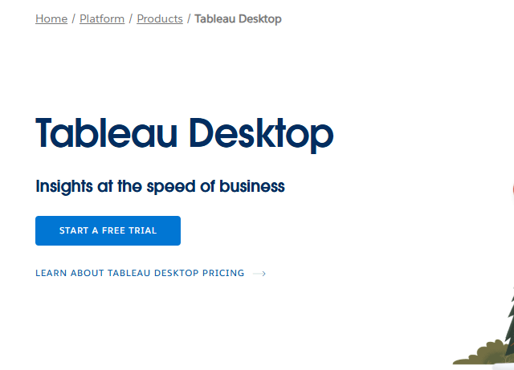
How to Install Tableau?
Follow this link - https://www.tableau.com/products/desktop
Click on “Start a Free Trial”, Automatically, the download will start.

Slide 30
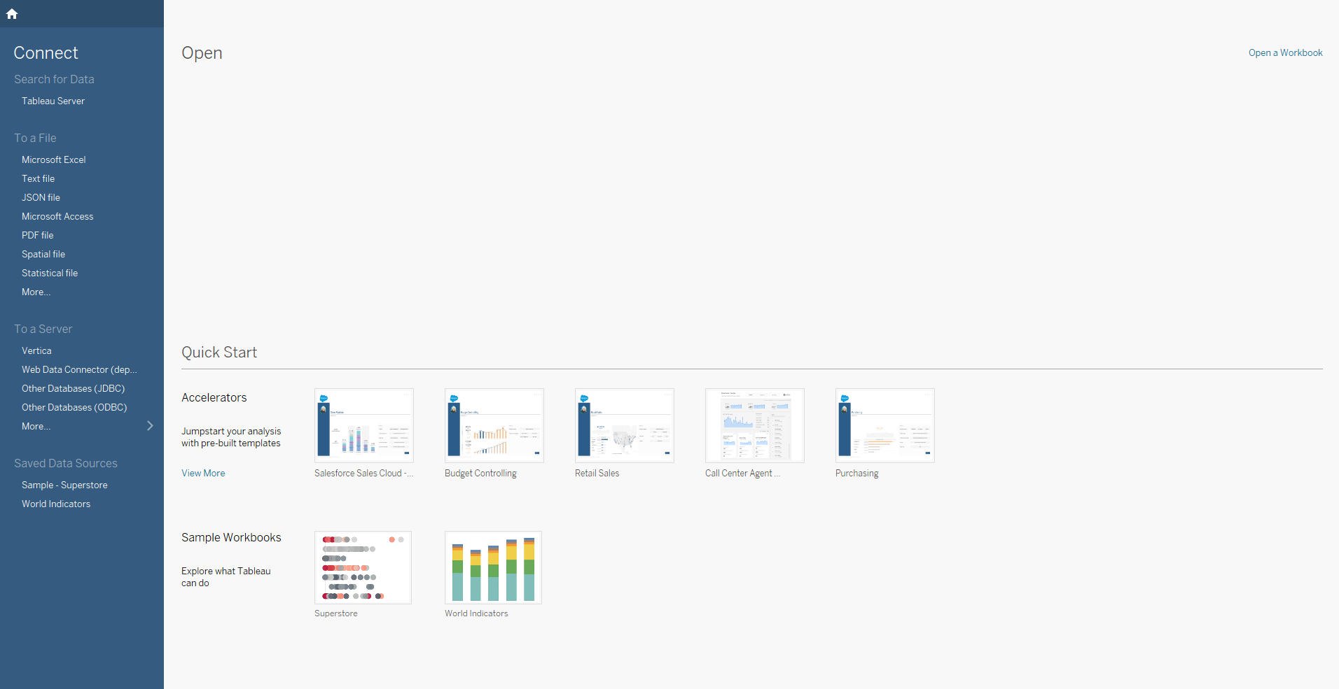
How to Install Tableau?
After downloading,
Follow the instructions
Enter your email id
And click on “Activate for 14 days”
You will then be taken to this landing screen:

